Slide 1
BLACK FRIDAY
Exploratory Data Analysis
Understanding customer purchase behavior through the Black Friday retail transactions dataset

Slide 2
What we'll cover
Dataset Overview
Dataset Cleaning
01
02
Firstly, we will figure out the meaning and the uses of the column given.
Filling the empty or incorrectly filled data with an appropriate value and removing the unwanted data.
Visualization of the results
Drawing key insights from the results
03
04
By the use of matplotlib, we will visualize the results in graphs , pie charts , histogram , scatter graph.
Write a meaningful conclusion that can be drawn from the result.

Slide 3
Dataset overview
12
Feature columns
3623
Unique Customers
550,068
Transaction Rows
5891
Unique Products
Key Fields
User ID , Product ID – Transaction details
Gender , Age , Occupation , Marital Status – Demographic Profile of the Customers
No. years a person has stayed in the city , City category – Geographical Profile of the Customers
Product Category 1 , Product Category 2 , Product Category 3
Purchase amount – Transaction amount [Main target]

Slide 4
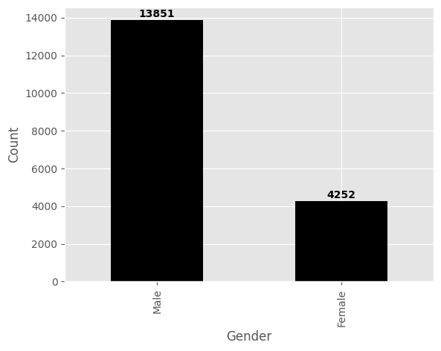
Customer demographics — gender & age
Key Insights
The most number of the purchasers are from the age group of 26-35.
Male purchasers are 4 times the number of Female purchasers.

Slide 5
Marital status & City category
Key Insights
Most purchasers are from City B and hence we can open more stores in City B to cater more customers.
As most purchasers are unmarried , we can increase the stock of goods that are mostly used by bachelors to increase the sales.

Slide 6
Years of residence in current city
Key Insights
As most of the purchasers are staying only for around 1 year , they will be in a need of products like furniture and kitchen utensils so we can take the benefit of this need to increase our profit as well us it to clear stock with discounts.

Slide 7
Key Insights
Total number of male shoppers are 4,14,259. Total number of female shoppers are 1,35,809.
The most common age group of shoppers is 26-35.
The most number of shoppers are from city B.
There are 2474 unique married shoppers.
There are 3417 unique unmarried shoppers.
The total purchase by Male is 1,81,12,44,855. The total purchase by Female is 54,89,30,546.
Product category 2 has sold the most number of goods.
The product which has product id 'P00025442' has been purchased the most number of times.

Slide 8
Thank You

